Slide 1
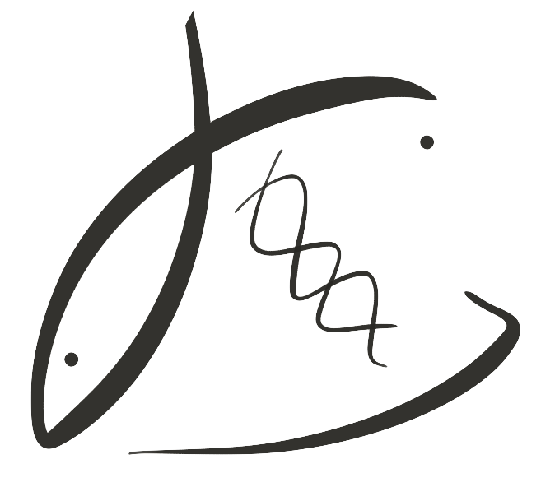





Parental winter exposures influence Olympia oyster larvae
Laura H Spencer
Roberts Lab
School of Aquatic and Fishery Sciences
University of Washington
NSA-PCS/PCSGA 2019 in Portland, OR
https://laurahspencer.github.io/LabNotebook/

Slide 2
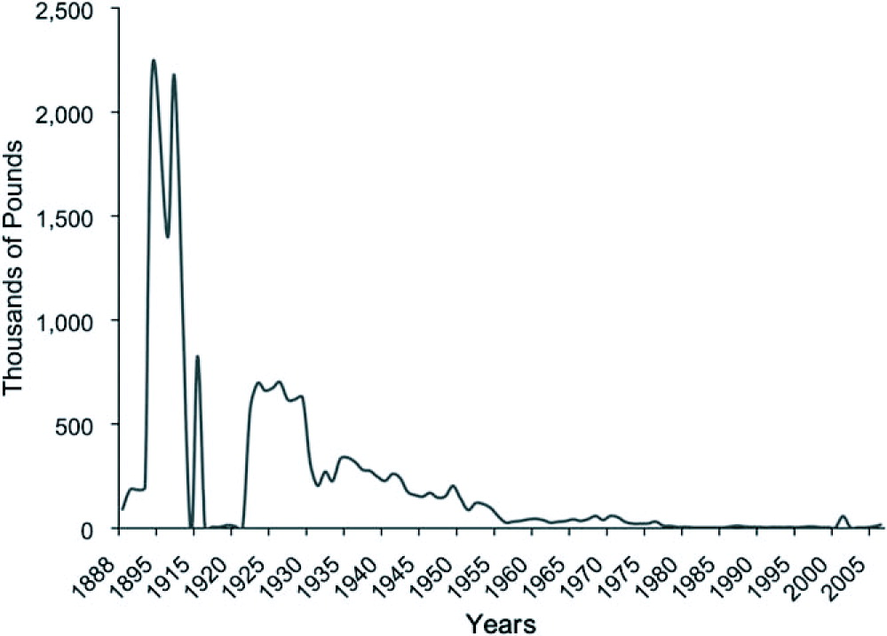
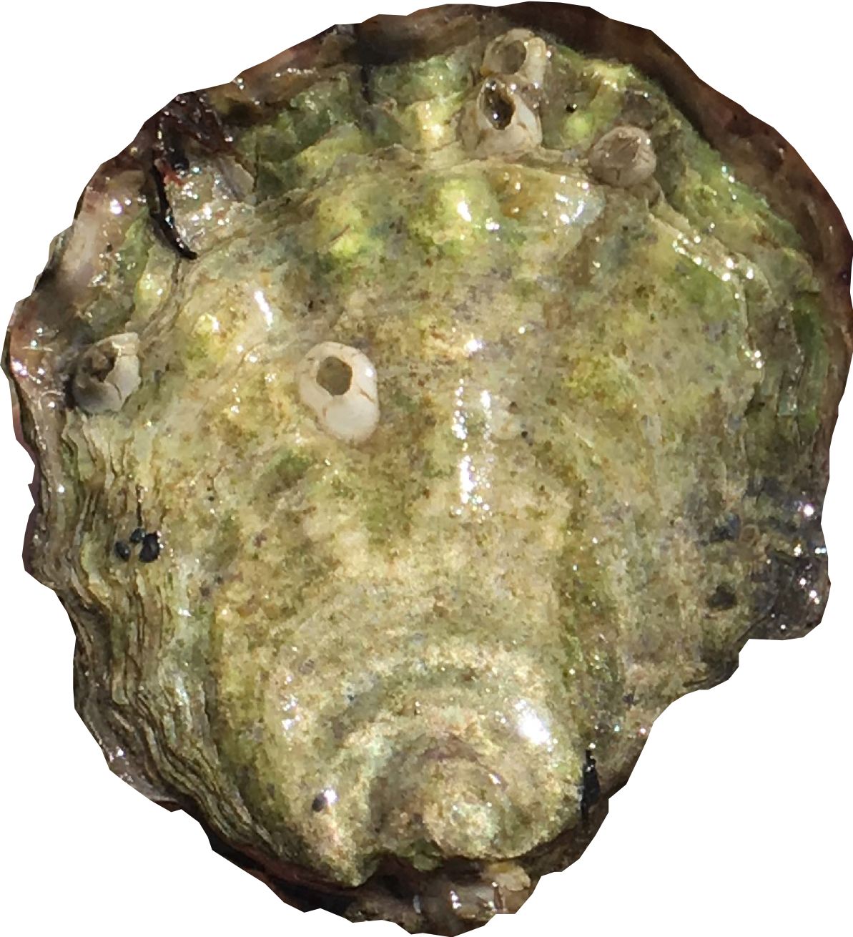
The Olympia oyster
Pacific Coast’s only native oyster, populations crashed early 1900’s
White, Ruesink & Trimble 2009, J. of Shellfish Research
Notes:
MAP: Augmented map of 2009 Olympia oyster survey that found some locations Olys are absent entirely or absent in the intertidal.

Slide 3
The Olympia oyster
Potential threats: warming & acidification
Rising temperatures
Marine heat waves
Milder winters
Shifting carbonate chemistry
Puget Sound pH lowest in winter
Winter temp. anomaly (JFM) 2015
Puget Sound pH by month, 25-yr dataset
Di Lorenzo & Mantua 2016
Nature Climate Change
Lowe, Bos & Ruesink 2019
Nature Scientific Reports
Notes:
WINTER warming could change phenology
NEW BLOB FORMING?
a,b, January–February–March (JFM) 2014 SSTa and SLPa, respectively. c,d, October–November–December (OND) 2014 SSTa and SLPa, respectively. e,f, JFM 2015 SSTa and SLPa, respectively. The blue box in a denotes region used to compute the GOA SSTa index. The red box in e denotes region used to compute the ARC SSTa index. The mean position and direction of the North Pacific Current (NPC) and gyre circulation in the North Pacific Ocean is indicated with the grey arrows in panel a. Std: units of standard deviation.
LOWE
Figure 3. Seasonal variation of observed pH and %DO. (a) Mean monthly site-specifc pH (points), distribution of predicted ‘atmospheric equilibrium’ pH across all sites for each month (boxplots), and the probability of observing aragonite supersaturation within the entire sampling region in a given month (dashed line corresponding to right axis). Color of points correspond to the magnitude of the metabolic efect on pH (observed pH minus ‘atmospheric equilibrium’ pH) as indicated in the legend (same as Fig. 1). Shape of points indicates habitat of the site: triangle = channel, open circle = nearshore, flled circle = tidefat

Slide 4
Ocean acidification, Olympia oyster
Negative impacts of larval exposure
⬇ Larval growth, survival (Hettinger et al. 2013)
⬇ Juvenile growth after larval exposure (Hettinger et al. 2012)
Also evidence of larval tolerance (Waldbusser et al. 2016)
Notes:
Change font to make title way different
Make Waldbusser’s paper pose a question … another author shows tolerance, maybe
Parental exposure? On next slide (and/or talk more about waldbusser)

Slide 5
Parental carryover effects?
Notes:
Put question on the next slide … one slide with “Olympia oyster? Mechanisms?”
Parental exposure can influence offspring response to stress (e.g. Parker et al. 2012)
This may allow oyster populations to quickly respond to changing ocean
Parker 2012:
Parents exposed during reproductive conditioning
Larvae from exposed parents larger, grew faster
Larvae exposed to low pH did OK if parent was exposed. BUT, if exposed to a secondary stressor, not OK

Slide 6
“Memory” of OA passed on to offspring, other oysters
Negative carry-over:
⬇ larval survival (Venkataraman et al. 2019)
Positive carry-over:
⬆ larval growth (Parker et al. 2012, 2015, 2017)
Notes:
Put question on the next slide … one slide with “Olympia oyster? Mechanisms?”
Parental exposure can influence offspring response to stress (e.g. Parker et al. 2012)
This may allow oyster populations to quickly respond to changing ocean
Parker 2012:
Parents exposed during reproductive conditioning
Larvae from exposed parents larger, grew faster
Larvae exposed to low pH did OK if parent was exposed. BUT, if exposed to a secondary stressor, not OK

Slide 7
Olympia oyster?
Notes:
Put question on the next slide … one slide with “Olympia oyster? Mechanisms?”
Parental exposure can influence offspring response to stress (e.g. Parker et al. 2012)
This may allow oyster populations to quickly respond to changing ocean
Parker 2012:
Parents exposed during reproductive conditioning
Larvae from exposed parents larger, grew faster
Larvae exposed to low pH did OK if parent was exposed. BUT, if exposed to a secondary stressor, not OK

Slide 8
Design
Time
Phase
Conditions
Adults in temperature treatment
(60 days, Dec. & Jan.)
Cold (6°C) Warm (10°C)
Adults in pH treatment
(52 days, Feb. & Mar.)
Low (7.3) Ambient (7.8)
Adults conditioned / induced to spawn
(30 days, Apr.)
Spawning temperature
(18°C)
Ambient pH
(7.8)
Larvae collected
(60 days, May - June)
Larvae collected
(60 days, May - June)
Notes:
Change Colors …
Remove metrics
Include pretty pictures or icons
Emphasize when pH treatment occurred
Use simplified flow chart here and on each results slide
Conditions === weeks before spawning. Wasnted to do treatment before active gametogenesis.

Slide 9
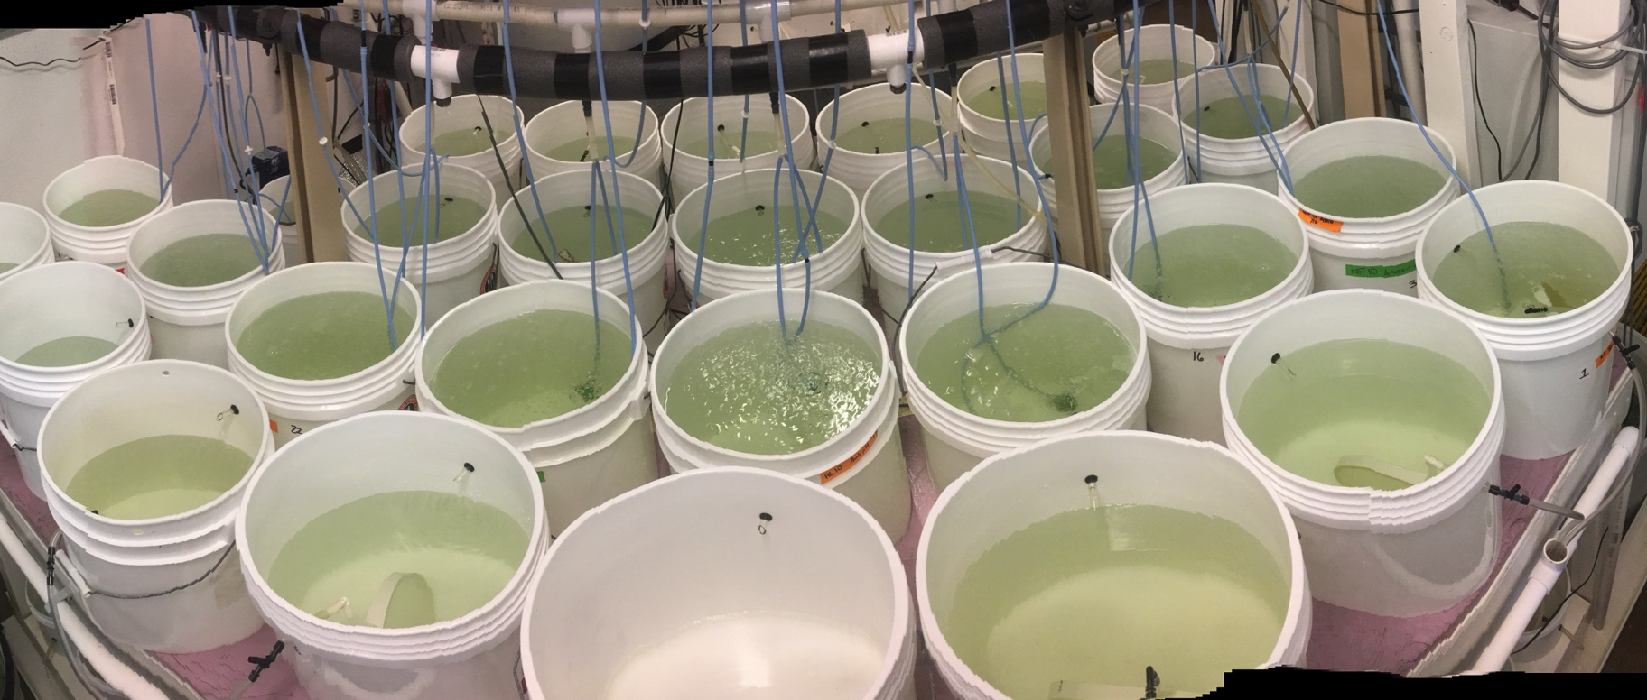
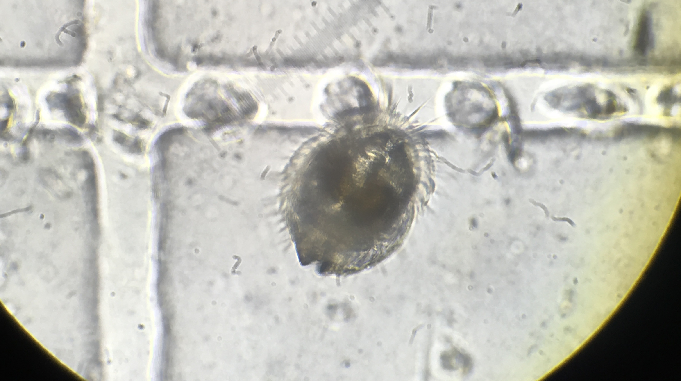
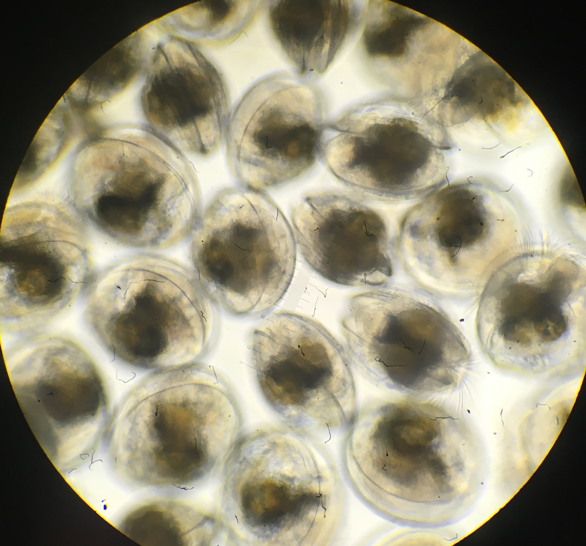
Larvae collected for 60 days, measured upon released
Adults in temperature treatment
Adults in pH treatment
Adults conditioned
Larvae collected

Slide 10
Newly released larvae
shell size ~ parental winter treatment
Adults in temperature treatment
Warmer = ⬆ shell size
Lower pH = ⬆ shell size
Adults in pH treatment
Adults conditioned
Larvae collected
Notes:
Why size differences?

Slide 11
Why larger larvae from adults exposed to ⬆ Temp, ⬇ pH in winter?
Direct parental influence – brood time & lipid resources
Indirect parental influence – change to larval physiology (epigenetic?)
Notes:
All possible explanations:
More energy available larger eggs?
Brood time?
More energy available via higher quality lipids?
More efficient use of resources?
Physiological change that’s transferred to offspring? - investigating these using gene expression

Slide 12
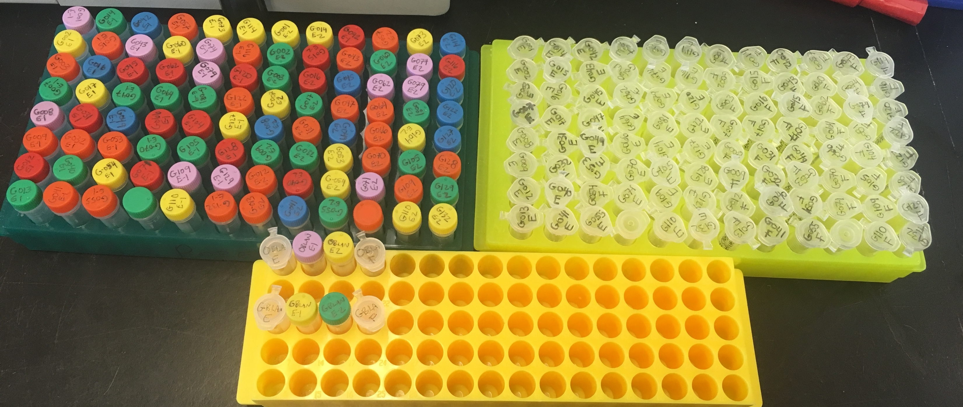

Larval RNA sequenced for gene expression
Adults in temperature treatment
Adults in pH treatment
Adults conditioned
Larvae collected

Slide 13
Newly released larvae
gene expression
PCA Biplot, normalized gene counts
Parental treatment
Adults in temperature treatment
6°C+Ambient pH
10°C+Low pH
Adults in pH treatment
rpl8
Tuba3-⍺
Processes:
Aerobic respiration (COI, Mt:ND5)
Cytoskeleton (Tuba3-⍺)
DNA repair (USP47)
Protein transport (TBC1D2)
Cytoplasmic translation (rpl8)
TBC1D2
Mt:ND5
USP47
Adults conditioned
COI
Larvae collected
COI: Cytochrome c oxidase, aerobic respiration
mt:ND5: NADH-ubiquinone oxidoreductase, mitochondrial electron transport
USP47: Ubiquitin component, DNA repair
TBC1D2: protein transport, GTPase activity
Tuba3a: Tubulin, cytoskeleton
Rpl8: ribosomal protein, cytoplasmic translation
Notes:
Mitochondrial efficiency – more efficient use of resoures
They are different!
Whether growth rates causing these difrerences, OR differences are causing growth rate
Cytochrome c oxidase is a key enzyme in aerobic metabolism.
THEN Speculation: something that is inherited fundamentally changed – mitochondria have
Connect back to size
MAKE MODEL TO SHOW GROWTH, REPR
Related to energy allocation?
Remind them why this is important for restoration …
I don’t know if this is good or bad

Slide 14
Newly released larvae
gene expression
PCA Biplot, normalized gene counts
Parental treatment
Adults in temperature treatment
6°C+Ambient pH
10°C+Low pH
Adults in pH treatment
Processes:
Aerobic respiration (COI, Mt:ND5)
Mt:ND5
Adults conditioned
COI
Maintenance
Larvae collected
Energy
Growth
mitochondria?
Reproduction
COI: Cytochrome c oxidase, aerobic respiration
mt:ND5: NADH-ubiquinone oxidoreductase, mitochondrial electron transport
USP47: Ubiquitin component, DNA repair
TBC1D2: protein transport, GTPase activity
Tuba3a: Tubulin, cytoskeleton
Rpl8: ribosomal protein, cytoplasmic translation
Notes:
Mitochondrial efficiency – more efficient use of resoures
They are different!
Whether growth rates causing these difrerences, OR differences are causing growth rate
Cytochrome c oxidase is a key enzyme in aerobic metabolism.
THEN Speculation: something that is inherited fundamentally changed – mitochondria have
Connect back to size
MAKE MODEL TO SHOW GROWTH, REPR
Related to energy allocation?
Remind them why this is important for restoration …
I don’t know if this is good or bad

Slide 15
What does this mean?
Parental winter exposures alters larval physiology … Future generations more capable in new/challenging conditions?
Parental winter environment influences larval size … may alter larval recruitment, dispersal
Notes:
THEN Speculation: something that is inherited fundamentally changed – mitochondria have
Connect back to size
MAKE MODEL TO SHOW GROWTH, REPR
Related to energy allocation?
Remind them why this is important for restoration …
I don’t know if this is good or bad

Slide 16
Next steps
More sequencing!
Larval samples – all treatments & populations
Adult gonad & ctenidia tissue – all treatments & populations
More results in preprint (in review)
https://doi.org/10.1101/616375

Slide 17
thank you
Collaborators: Katherine Silliman, Steven Roberts
Puget Sound Restoration Fund: Ryan, Stuart, Alice, Erin, Jade, Morgan, Brian, Betsy …
On-the-ground: Yaamini, Grace, Olivia, Megan, Rhonda, Kaitlyn, Lindsay, Duncan, Sam, Hollie, Steven, Steven’s kids, Brent, Mom & Ian, Rick, Jackie Padilla-Gamino lab

Slide 18
Adult gonad Gene expression
Adults in temperature treatment
PCA Biplot, normalized gene counts
Winter treatment
6°C+Ambient pH
10°C+Low pH
Adults in pH treatment
COI
Processes:
Aerobic respirationz (COI)
Cytoskeleton (⍺-Tub84B)
Adults conditioned
Larvae collected
⍺-Tub84B
Notes:
To explain this change to larval physiology, we are starting to look at what’s happening in the adults. Sarting by looking at gene expression in gonad tissue. This plot shows you global gene expression in adult gonad at the end of the treatmtenst, before spawning – shows that indeed there is difference, and some of the genes that are influencing the clustering are also related to aerobic respiration.
Because there is some overlap between gonad expression patterns, and larval expression patters weeks later, this supports our hypothtesis that there could be fundamental changes passed from parent to offspring.
UP
Thymidylate synthase Nucleotide biosynthesis
H/ACA ribonucleoprotein complex subunit DKC1 Ribosome biogenesis, rRNA processing
Elongation factor 1-delta protein biosynthesis
C-terminal-binding protein Transcription regulation
HSP70 protein stabilization
DOWN:
Defense response:
Macrophage-expressed gene 1 protein host defense against bacteria
Hemagglutinin/amebocyte aggregation factor aggregation of amebocytes and agglutination of erythrocytes
Coactosin-like protein defense response to fungus
Biosynthesis / cell regulation:
Haloacid dehalogenase-like hydrolase domain-containing 5 glycerophospholipid biosynthetic process
Protein quaking-B cell differentiation, mRNA processing, regulation of translation, RNA splicing
Endoglucanase cellulose cellulose catabolic process
Rho guanine nucleotide exchange factor 3 intracellular signal transduction
S-crystallin SL11 S-crystallins are structural components of squids and octopi eye lens. Contains relatively little if any GST activity

Slide 19
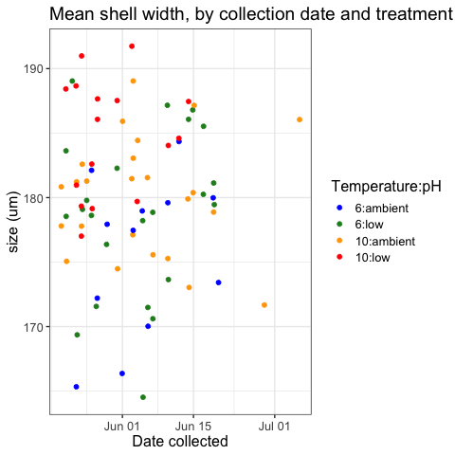

Slide 20
Larval gene expression
COI: Cytochrome c oxidase, aerobic respiration
mt:ND5: NADH-ubiquinone oxidoreductase, mitochondrial electron transport
USP47: Ubiquitin component, DNA repair
TBC1D2: protein transport, GTPase activity
Tuba3a: Tubulin, cytoskeleton
Rpl8: ribosomal protein, cytoplasmic translation

Slide 21
Gonad gene expression First look at differential expression
pH
Spawn & collect
Rear
Heat Shock Protein: stress response, protein chaperone / repair

Slide 22
Gonad gene expression First look at differential expression
pH
Spawn & collect
Rear
Cytochrome c oxidase: aerobic respiration

Slide 23
shift in larval energy budget?
stressful environment
=
⬆ energy for maintenance
More efficient mitochondria?
Growth
Energy
Maintenance
Not stressful environment
=
⬆ energy for growth
Reproduction

